Slide 1
Refining and visualizing sentiment data
Lab 3

Slide 2
Training Outcome
After completing this training, the participant should be able to:
Understand and apply the core tools used to process and analyze big data.
Identify the components of a Hadoop platform and application framework
Be familiar with Hadoop platform such as hortonwork.
Hands on walk through example with hadoop platform (e.g hortonwork)
Take practical steps to begin a success big data initiative

Slide 3
Training Outline
Hadoop Component such as Pig, hive and Catalog
Hand on exploration of the Hortonworks VM

Slide 4
Prerequisites
Hortonworks Sandbox v2.1
Oracle VM
Hortonworks ODBC driver
WinSCP

Slide 5
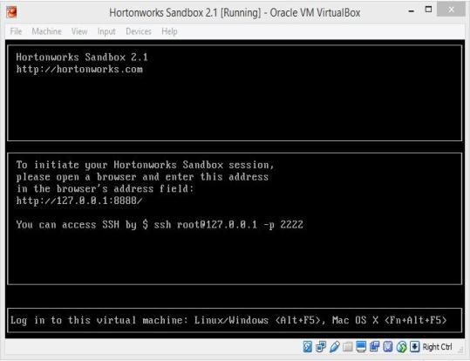
Step 1 : Install all the prerequisites
Install WinSCP
Install Hortonworks ODBC driver
Install Oracle VM Virtualbox 5.0.2
Install Hortonworks Sandbox on Oracle VM Virtualbox.
Launch the Sandbox and let it running until it shows like Figure 1
Figure 1

Slide 6
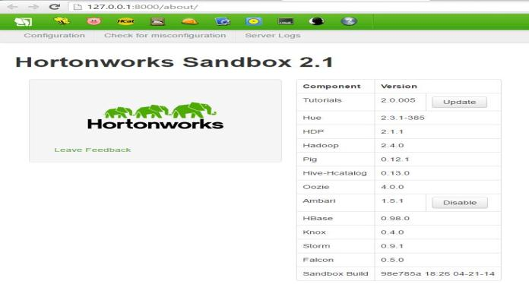
Open a browser and go to http://127.0.0.1:8888
Enable the Ambari (refer Figure 2)
Figure 2

Slide 7
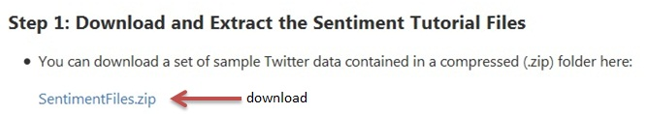
Step 2 : Download and extract sentiment files
Go to https://github.com/hortonworks/hadoop-tutorials/blob/master/Sandbox/T13_Refining_and_Visualizing_Sentiment_Data.md
Download SentimentFiles.zip (refer Figure 3 )
Extract the files. You should see SentimentFiles folder
Figure 3

Slide 8
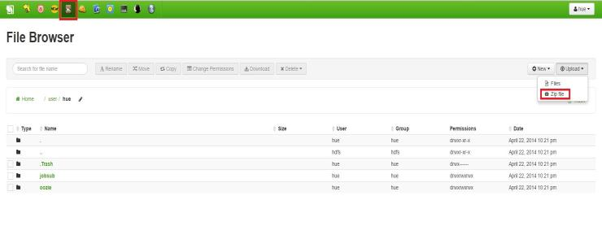
Step 3 : Load Twitter Data into Hortonworks Sandbox
Navigate to File Browser tab
Click upload → Zip File (refer Figure 4)
Figure 4

Slide 9
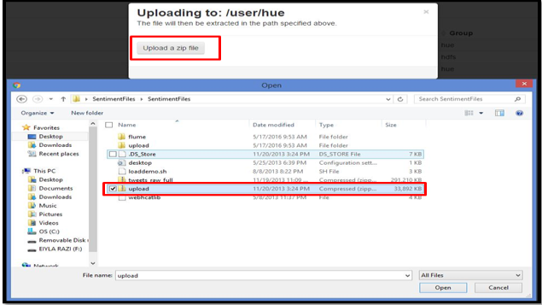
Click upload zip file
Navigate to sentimentfiles folder and choose upload.zip (refer Figure 5)
Figure 5

Slide 10
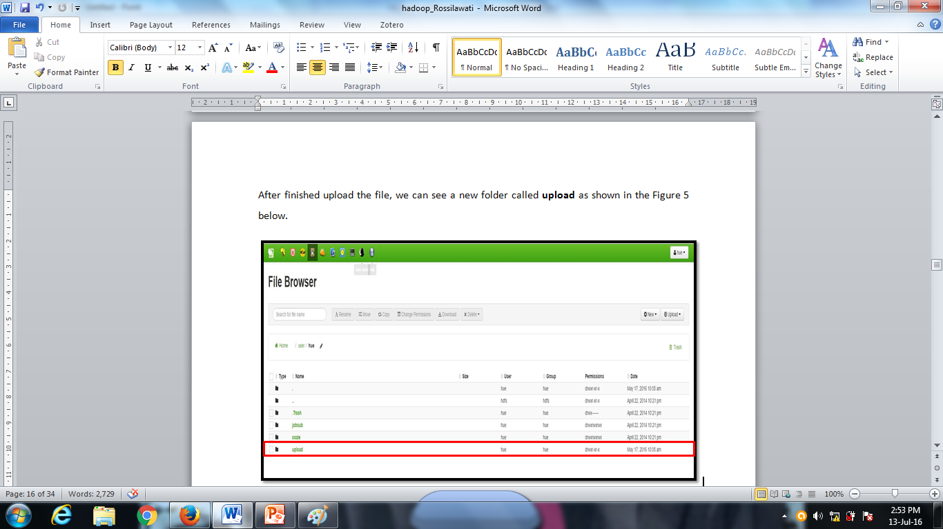
After completing the upload, you will see a new folder called upload (refer Figure 6)
Figure 6

Slide 11
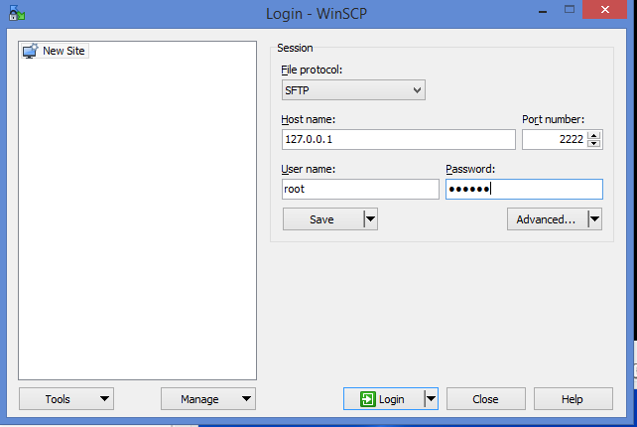
Step 4 : Copy a hive script to the Sandbox
Open WinSCP
Type the following setting
Host name : 127.0.0.1
Port : 2222
Username : root
Password : hadoop
Click login
(refer Figure 7)
Figure 7

Slide 12
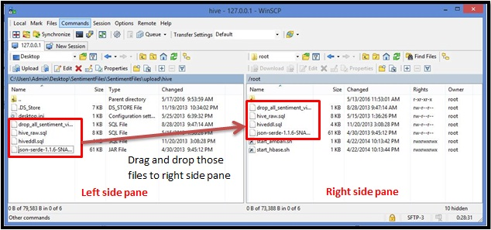
Use WinSCP file browser to navigate to the Sentimentfiles/hive folder in the left hand pane.
Drag and drop hiveddl.sql file. Make sure in root Sandbox ( right side pane) already have hive_raw.sql, json-serde-1.1.6-SNA.sql, and drop_all_sentiment_views_and_tables.sql. If not, drag and drop also those files (refer Figure 8)
Figure 8

Slide 13
Step 5 : Run hive script to refine raw data
In the Hortonworks Sandbox virtual machine console window, press ALT + F5 key then login to the Sandbox using following username and password
Username : root
Password : hadoop
After login, command prompt will appear with prefix [root@sandbox~]#:
At the command prompt, type the following command and press enter
hive –f hiveddl.sql
(Refer Figure 9)
(this command is use to convert raw data into tabular format)

Slide 14
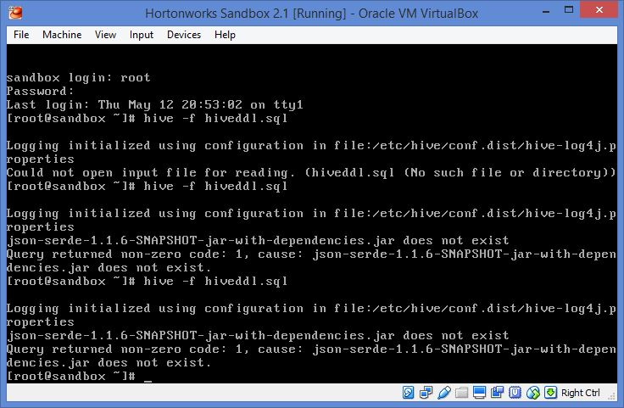
Figure 9

Slide 15
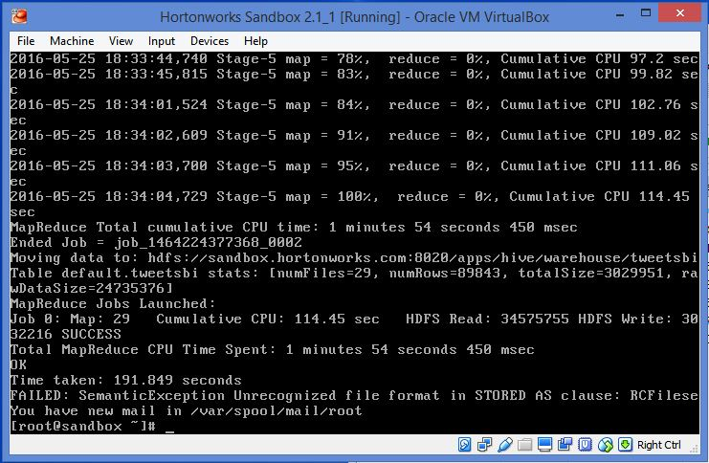
Once you press enter, you will see lines of text appear as the script runs a series of MapReduce jobs. It will take a few minutes for the script to finish running. When the script has finished running, the time taken is displayed, and the normal command prompt appears as shown in Figure 10
Figure 10

Slide 16
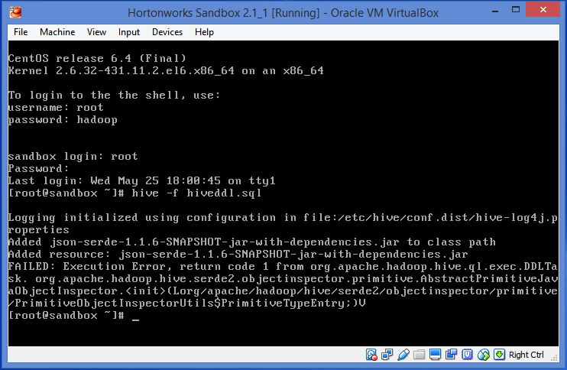
BUT, if you get the error (Execution Error) as shown in the Figure 11 below (do steps in the slide 17)
Figure 11

Slide 17
To fix execution error
Open hiveddl.sql file and make changes to the following (refer Figure 12)
Remove or comment the first line
On row 34, change to ROW FORMAT SERDE ‘org.apache.hive.hcatalog.data.JsonSerDe’
After make changes, run once again command hive –f hiveddl.sql

Slide 18
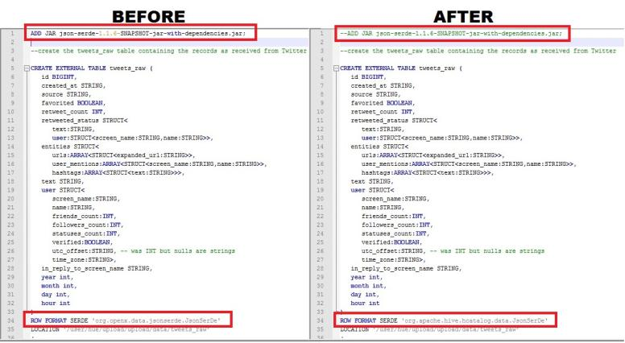
Figure 12

Slide 19
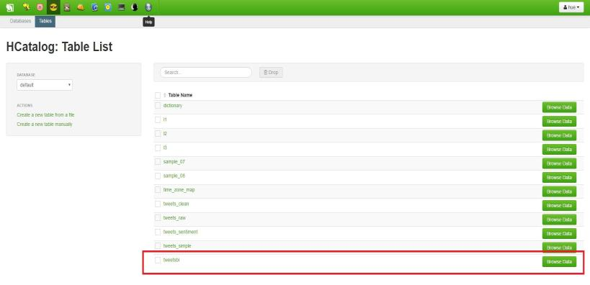
To see the data that have been created by hive script, click Hcatalog, you will see the ‘tweetsbi’ table. (refer Figure 13)
Click Browse Data to take a look at the data (refer Figure 14)
Figure 13

Slide 20
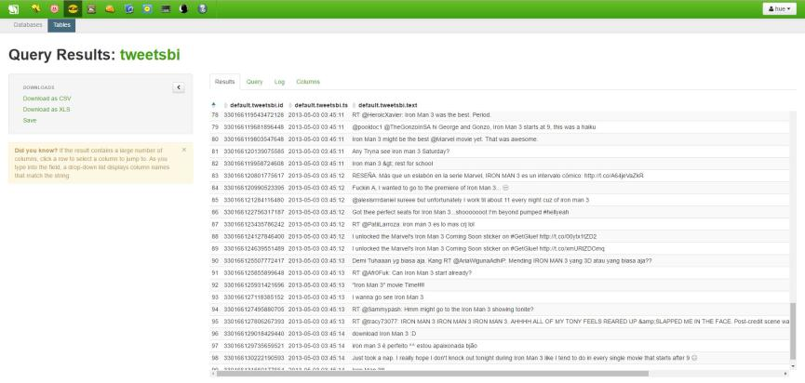
When you click browse data, you will see like figure below. You need to scroll right to see all the columns
Figure 14

Slide 21
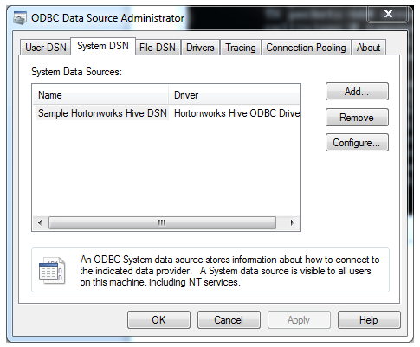
Step 6 : Access the refined sentiment data with excel
Open ODBC Data Source Administrator
Select System DSN tab, there should be Sample Hortonworks Hive DSN that selected by default, if not select it
Click Configure to continue
refer figure 15
Figure 15

Slide 22
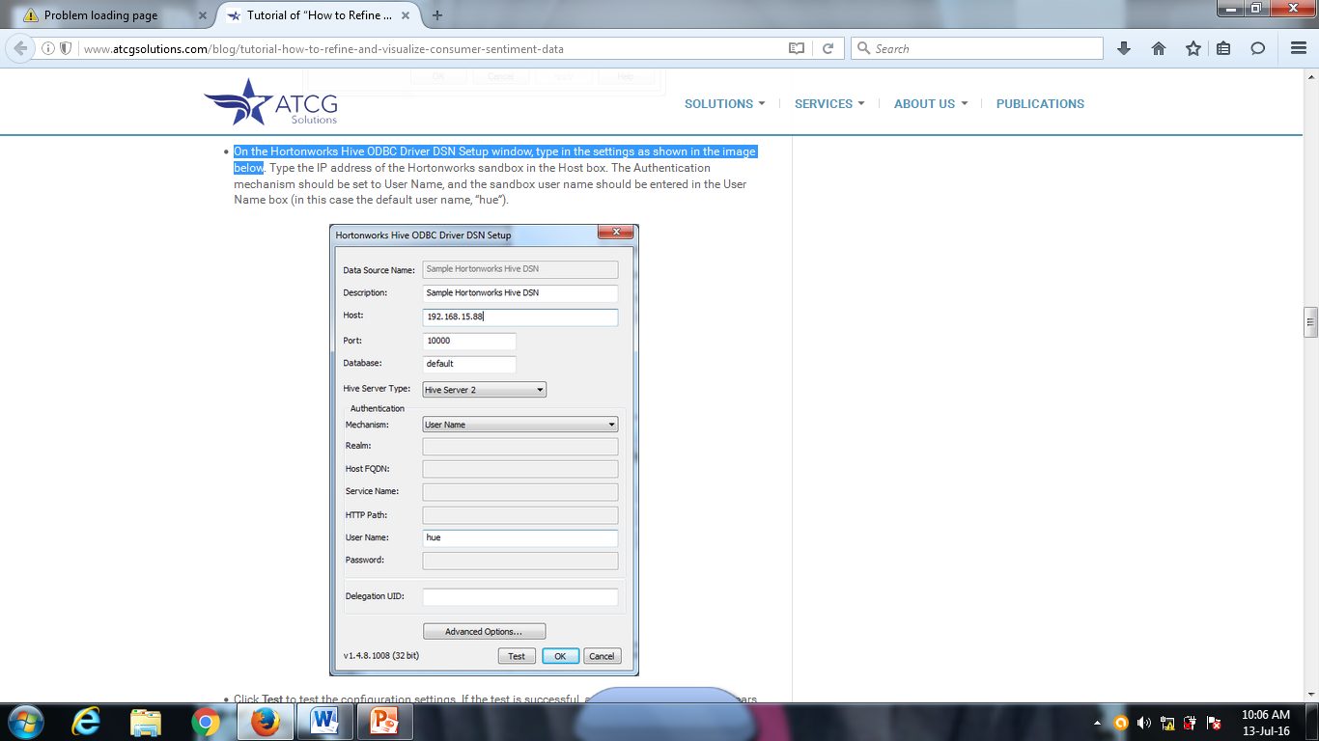
On the Hortonworks Hive ODBC Driver DSN Setup window, type in the settings as shown in the Figure 16
Host : 127.0.0.1
Username : hue
Figure 16

Slide 23
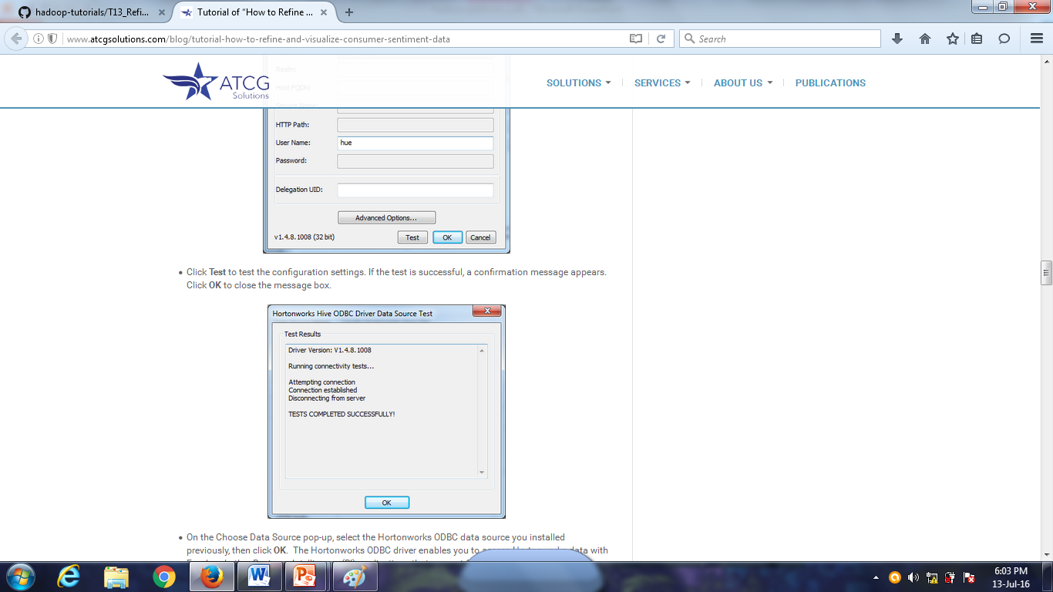
Click Test to test the configuration settings. If the test is successful, a confirmation message appears. (refer Figure 17)
Click OK to close the message box.
Figure 17

Slide 24
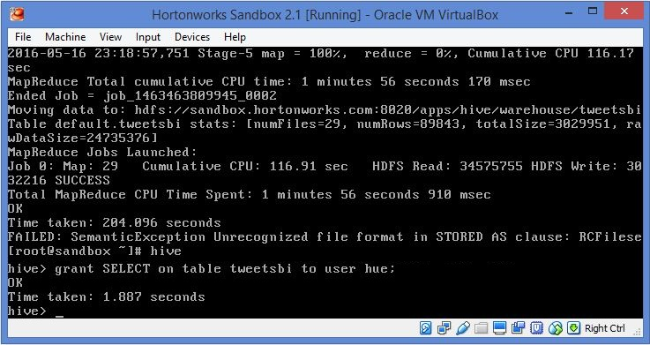
At the Sandbox terminal, type command hive then press enter
Command prompt with hive> will appear
At the command prompt, type in the following command and press enter (refer Figure 18)
grant SELECT on table tweetsbi to user hue;
Figure 18

Slide 25
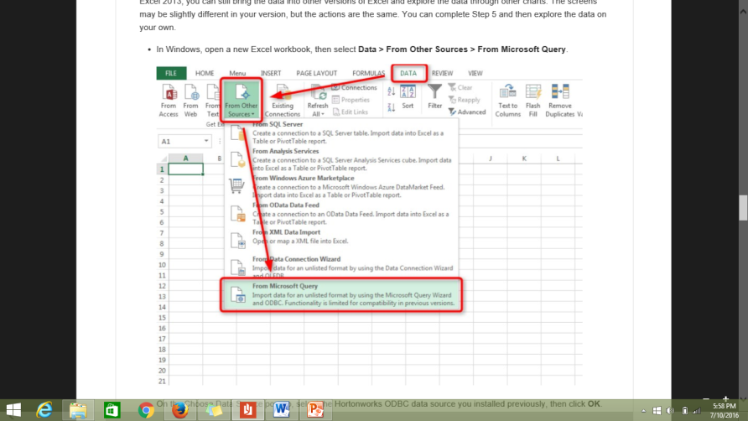
In Windows, open Excel Workbook
Select Data > From Other Sources > From Microsoft Query (refer Figure 19)
Figure 19

Slide 26
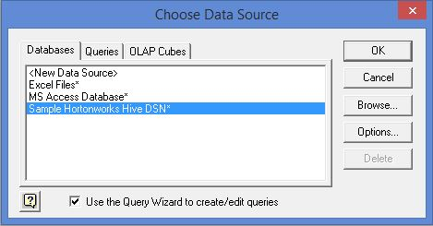
At Choose Data Source window, make sure it selected Sample Hortonworks Hive DSN, then click OK (refer Figure 20)
Figure 20

Slide 27
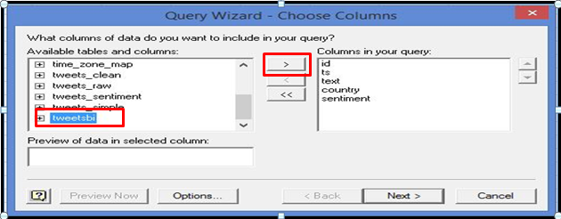
Next, Query Wizard window will appear. At this window, select ‘tweetsbi’ in the ‘available tables and columns’ box (refer Figure 21)
Then click at right arrow. You can see at the ‘columns in your query’ listed entire attribute in the ‘tweetsbi’ table (id, ts, text, country, sentiment) (refer Figure 21)
Figure 21

Slide 28
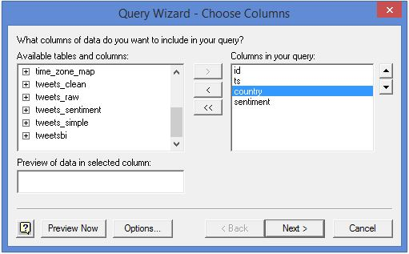
In the ‘columns in your query’, select text and then click left arrow to remove text attribute. So the attribute left should be id, ts, country and sentiment. (refer Figure 22)
Click Next to continue
Figure 22

Slide 29
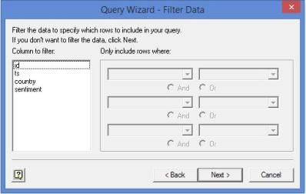
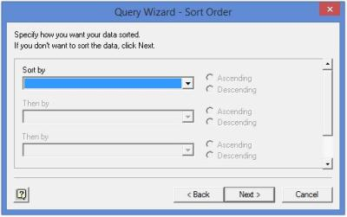
Then, Filter Data Screen window will appear. In this window just click Next without filtering (refer Figure 23)
Then, Sort Order Screen window will appear. In this window just click Next without sorting (refer Figure 24)
Figure 23
Figure 24

Slide 30
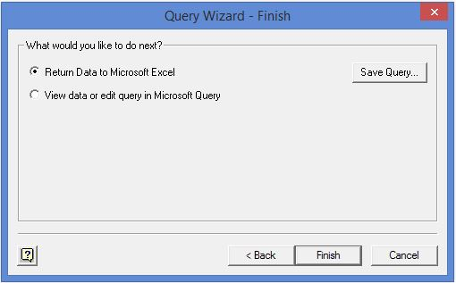
Then Query Wizard Finish window will appear. In this window click Finish button to retrieve query data from Sandbox and import it into Excel (refer Figure 25)
Figure 25

Slide 31
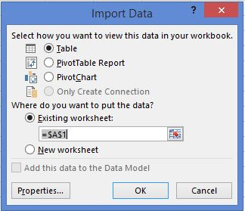
After that, Import Data Dialog box will appear. Click OK to accept the default setting (refer Figure 26)
Figure 26

Slide 32
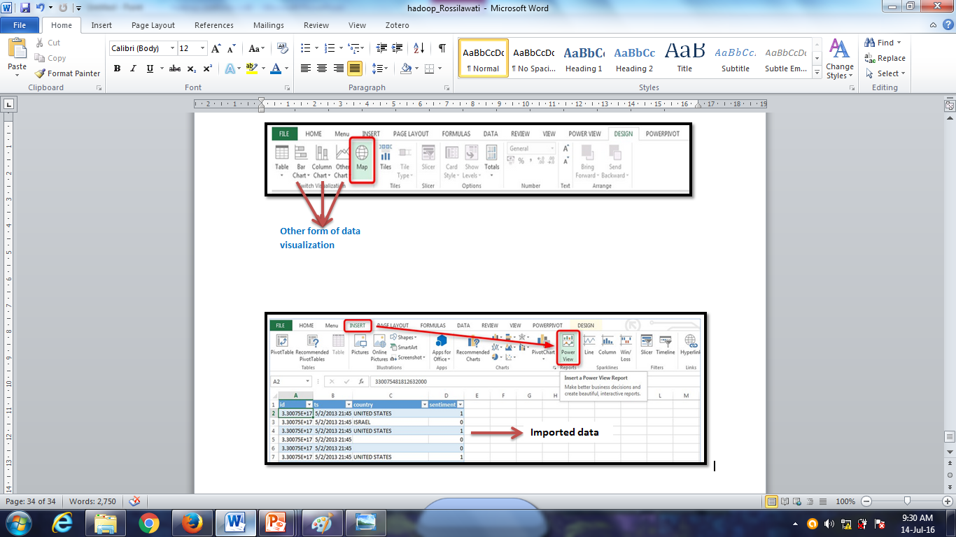
In the Excel Workbook, you can see all the query data have been imported.
Click Insert tab and choose Power View to open new power view report (refer Figure 27)
Figure 27

Slide 33
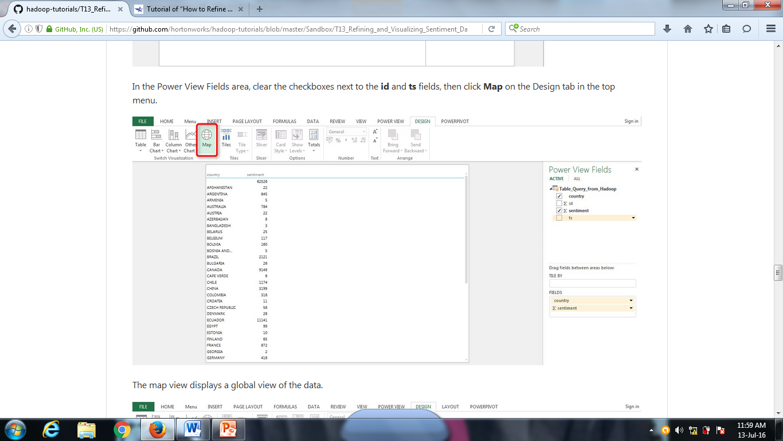
In the power view field, tick the checkbox for country and sentiment
Click Map in the Design tab (refer Figure 28)
Figure 28

Slide 34
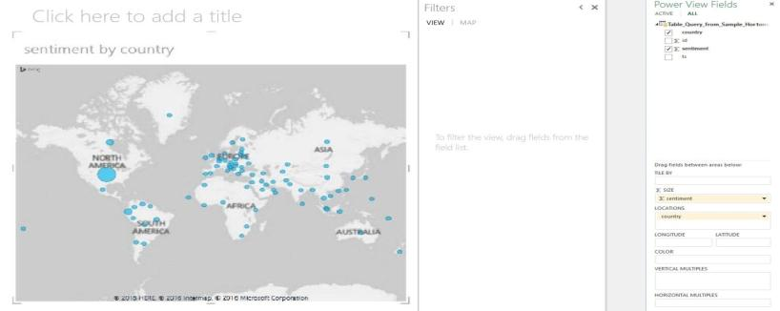
The map will display the global view of data as shown in Figure 29
Figure 29

Slide 35
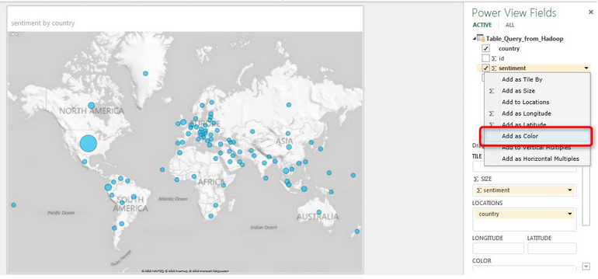
Now, to display sentiment data by color, in the power view field area, click sentiment then select Add as color (refer Figure 30)
Figure 30

Slide 36
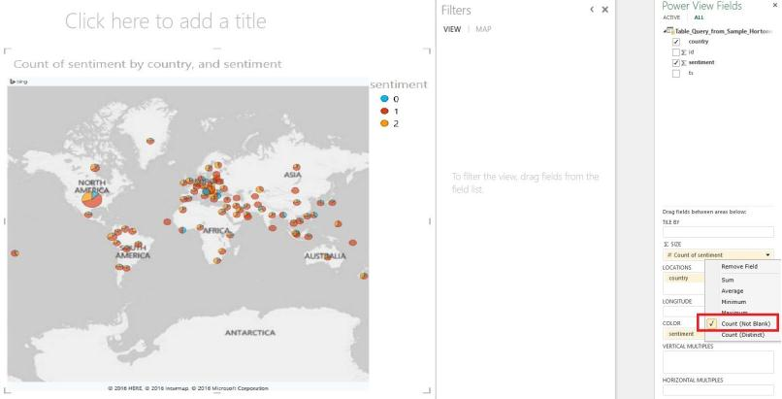
Then under the SIZE, click sentiment and select Count (Not Blank) (refer Figure 31)
Figure 31

Slide 37
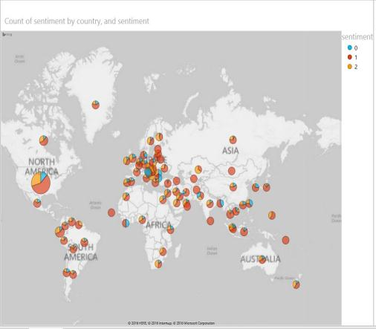
As refer to Figure 32, you can see the map displays the sentiment data by color
Blue : negative
Red : neutral
Orange : positive
Figure 32

Slide 38
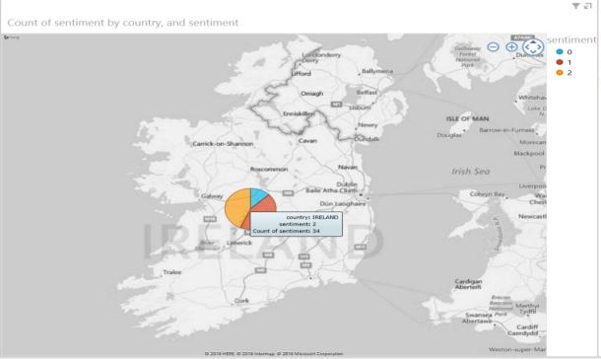
Now, use map control to zoom in any specific country. For example in the Figure 33, zoom in to see the sentiment in Ireland. In Ireland, we can see most tweets are neutral as indicated by red color
Figure 33

Slide 39
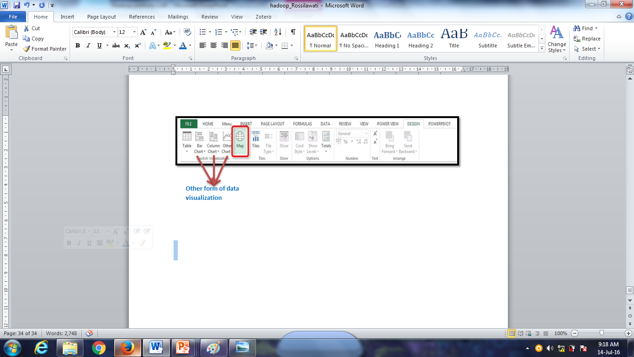
Besides map, you also can visualize sentiment data in other form such as pie chart, clustered chart and so on.

Slide 40
Discussion

